Slide 1
Recursion
Backtracking
Trees
Graphs
DP

Slide 2
Recursion backtracking

Slide 3
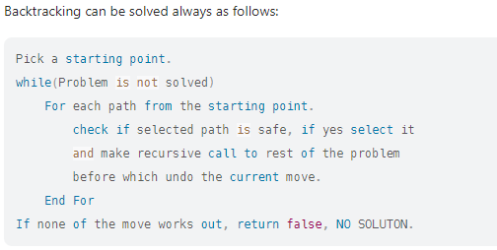

Slide 4
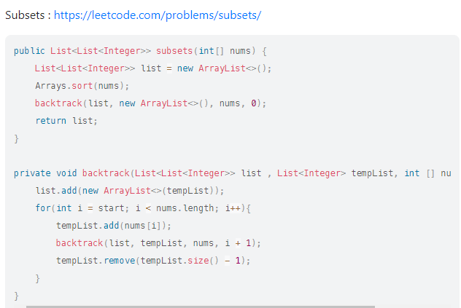
Subsets
https://leetcode.com/problems/subsets/

Slide 5
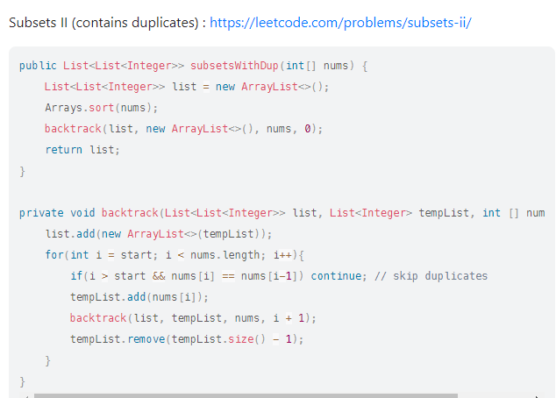
Subsets 2
https://leetcode.com/problems/subsets-ii/

Slide 6
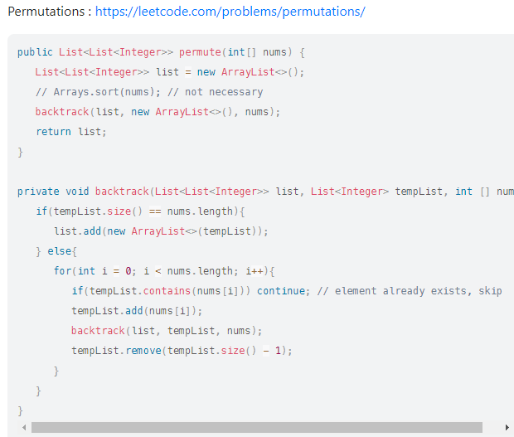
Permutations
https://leetcode.com/problems/permutations/

Slide 7
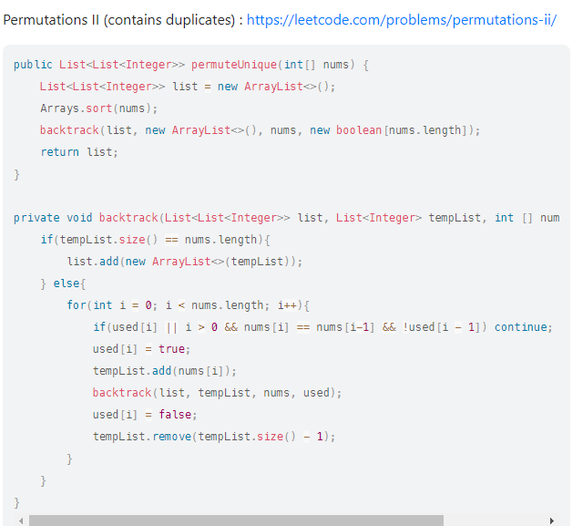
Permutations 2
https://leetcode.com/problems/permutations-ii/

Slide 8
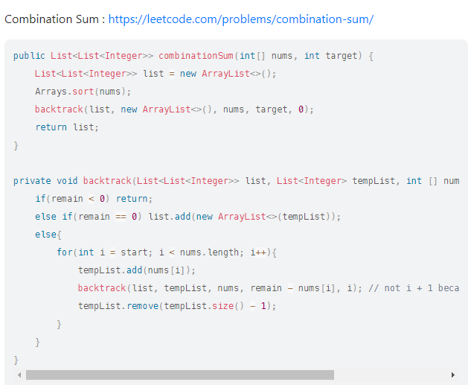
Combination sum
https://leetcode.com/problems/combination-sum/

Slide 9
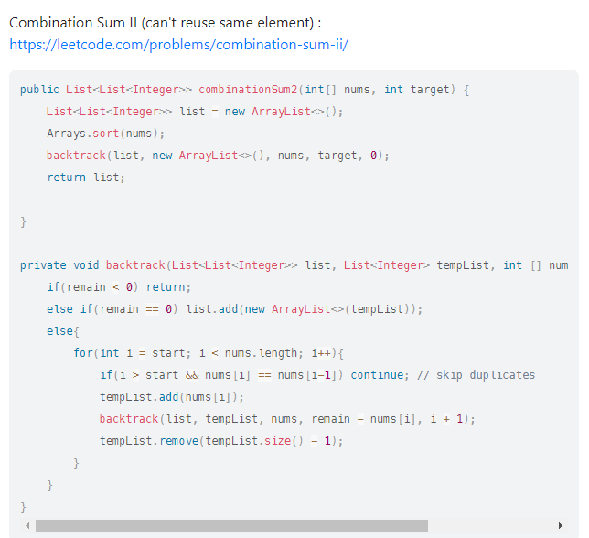
Combination sum 2
https://leetcode.com/problems/combination-sum-ii/

Slide 10
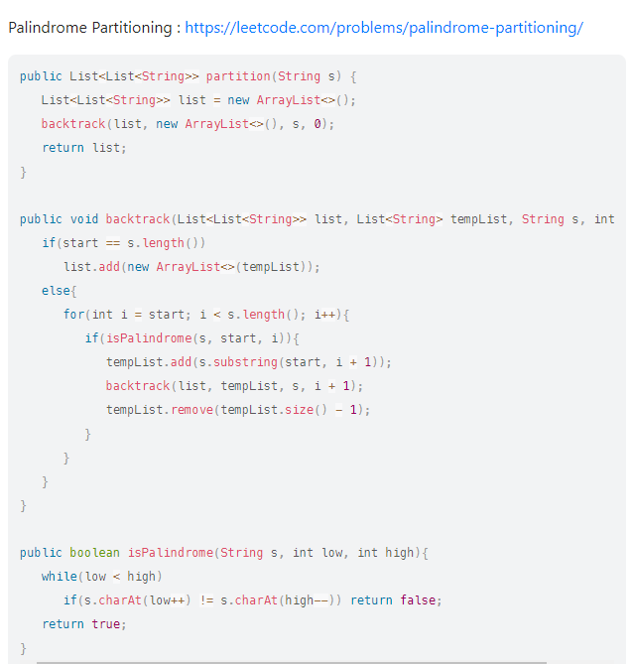
Palindrome partitioning
https://leetcode.com/problems/palindrome-partitioning/

Slide 11
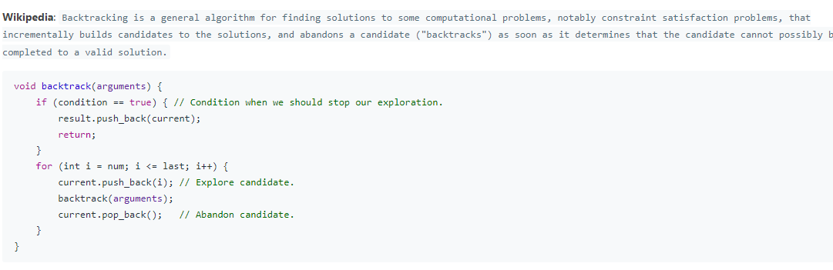

Slide 12
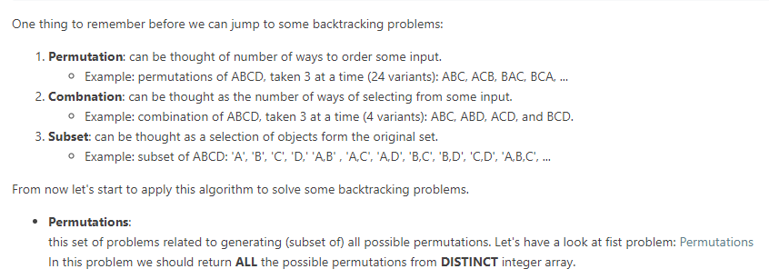

Slide 13
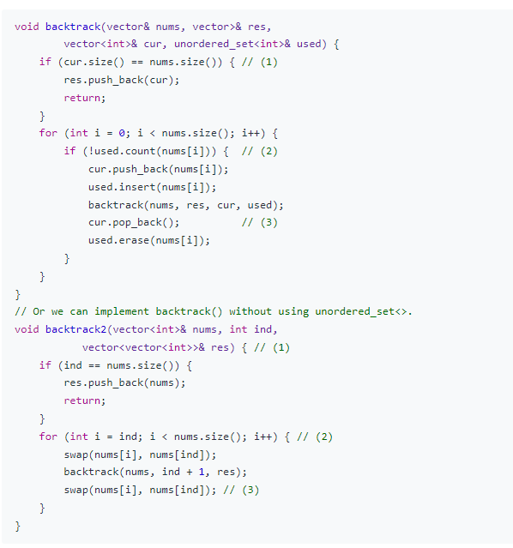

Slide 14
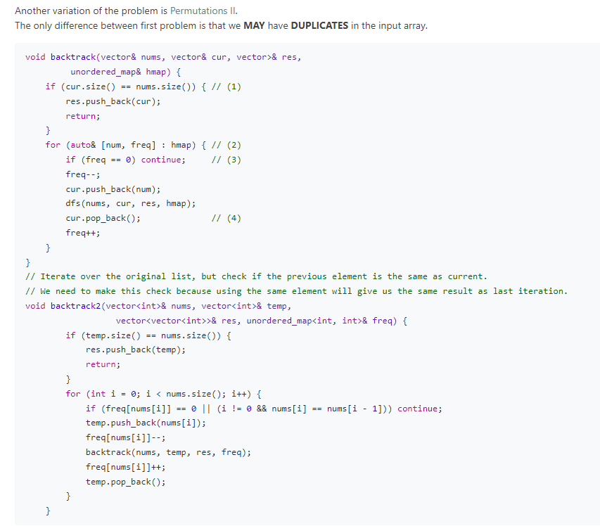

Slide 15
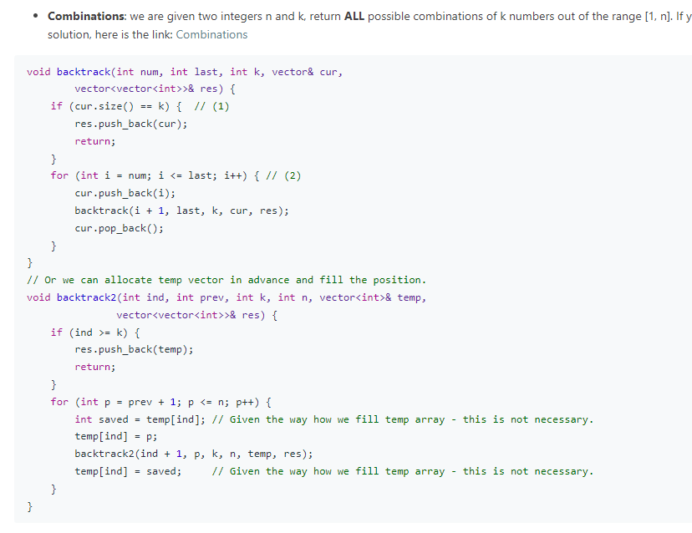

Slide 16
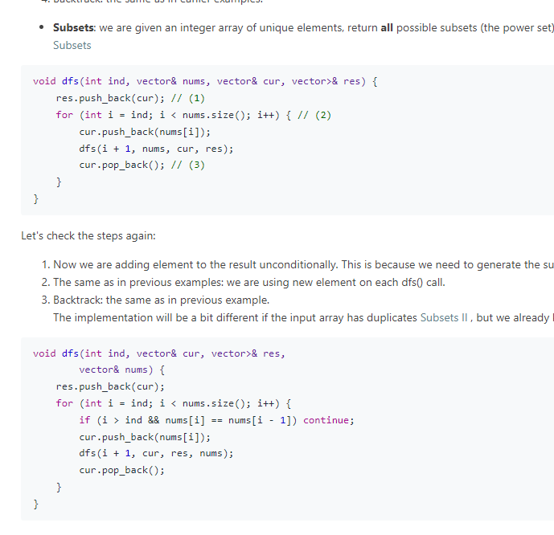

Slide 17
DYNAMIC
PROGRAMMING

Slide 18
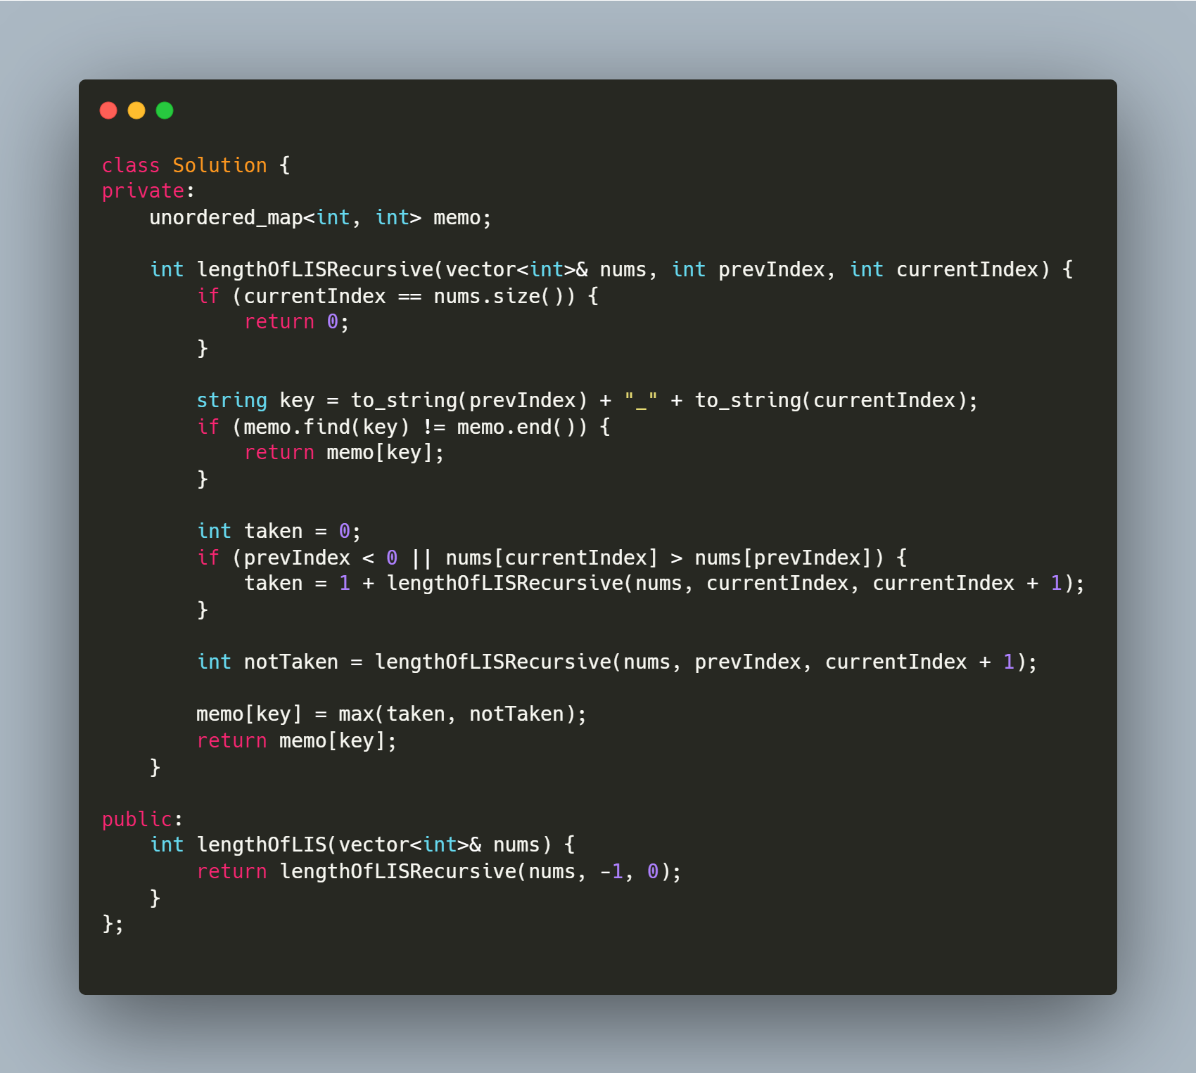
Longest increasing subsequence
Longest Increasing Subsequence
https://leetcode.com/problems/longest-increasing-subsequence/
https://leetcode.com/problems/largest-divisible-subset/
https://leetcode.com/problems/russian-doll-envelopes/
https://leetcode.com/problems/maximum-length-of-pair-chain/
https://leetcode.com/problems/number-of-longest-increasing-subsequence/
https://leetcode.com/problems/delete-and-earn/
https://leetcode.com/problems/longest-string-chain/

Slide 19
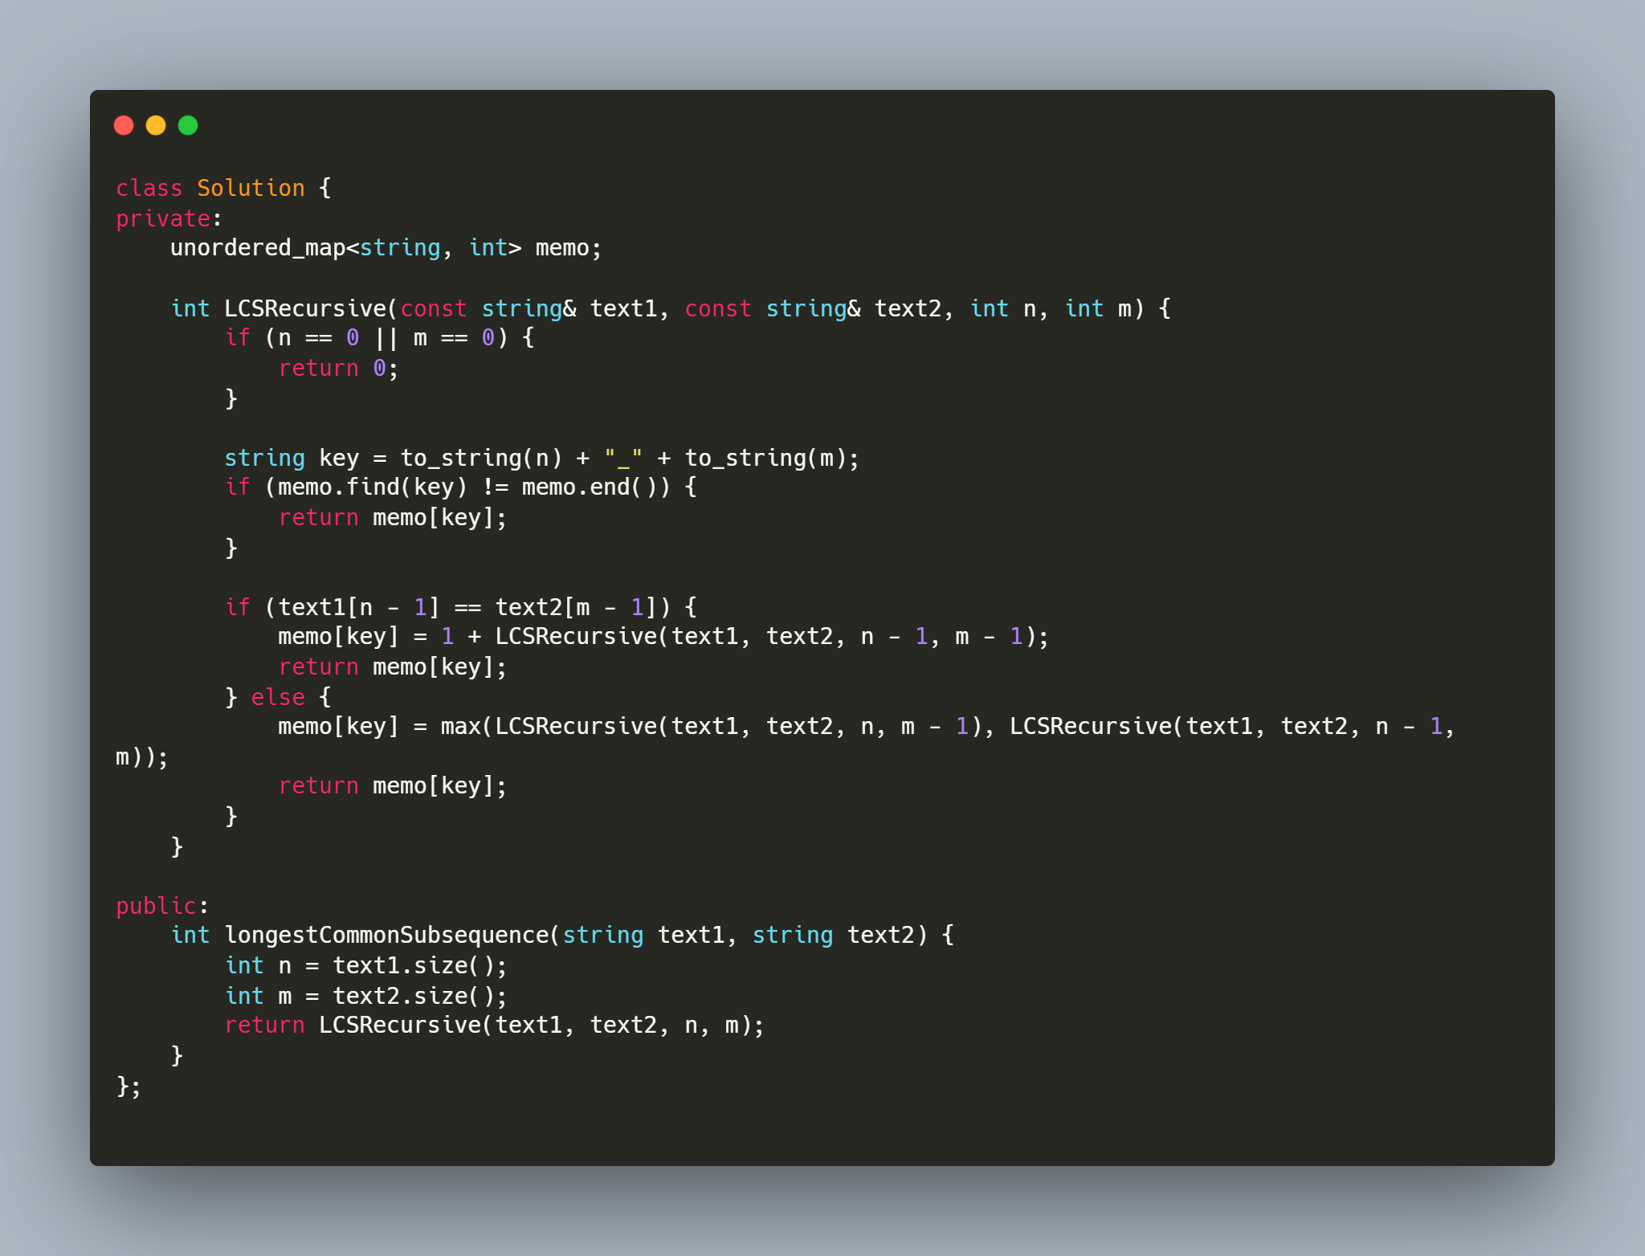
Longest common subsequence
Longest Common Subsequence
https://leetcode.com/problems/longest-common-subsequence/
https://leetcode.com/problems/edit-distance/
https://leetcode.com/problems/distinct-subsequences/
https://leetcode.com/problems/minimum-ascii-delete-sum-for-two-strings/

Slide 20
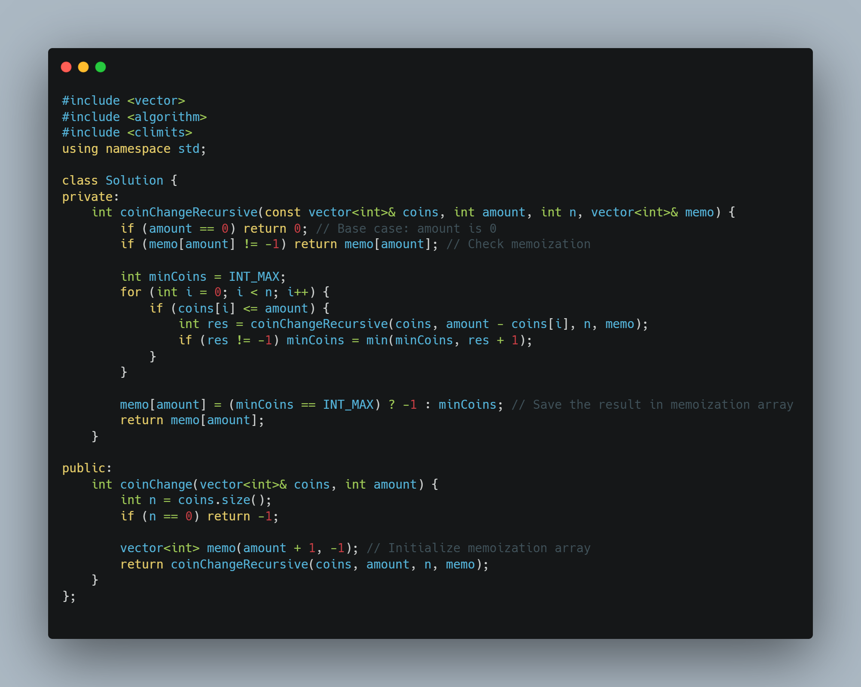
Coin change
Coin Change:
https://leetcode.com/problems/coin-change/
https://leetcode.com/problems/coin-change-2/
https://leetcode.com/problems/combination-sum-iv/
https://leetcode.com/problems/perfect-squares/
https://leetcode.com/problems/minimum-cost-for-tickets/

Slide 21
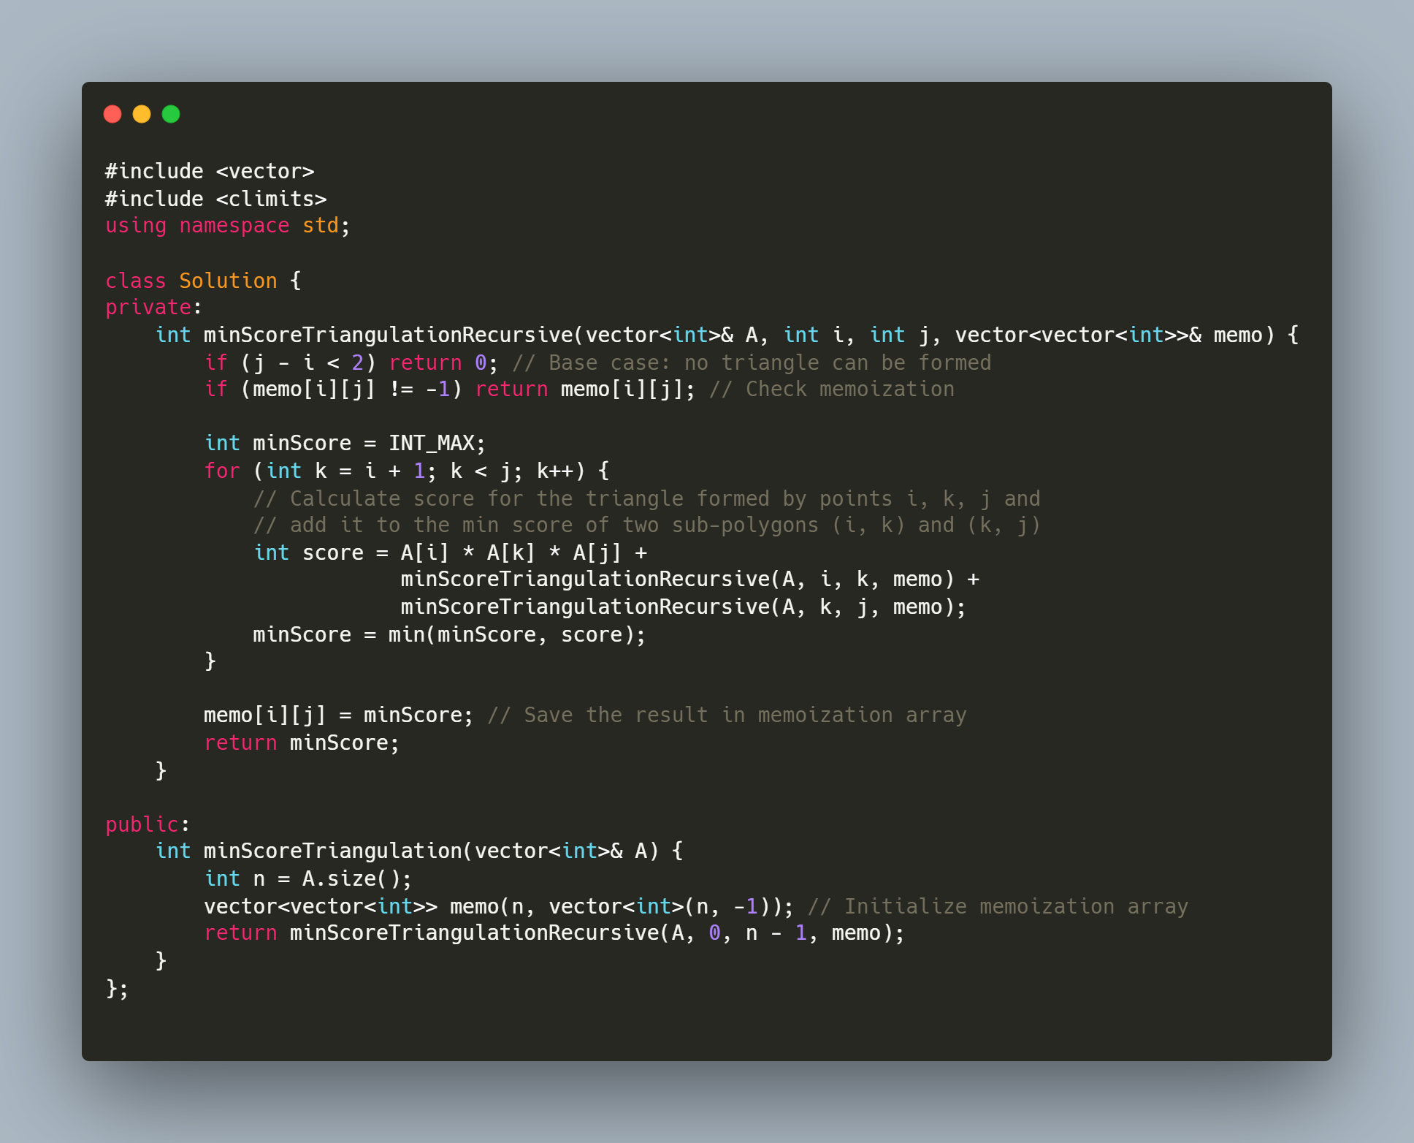
Matrix multiply
Matrix multiplication:
https://leetcode.com/problems/minimum-score-triangulation-of-polygon/
https://leetcode.com/problems/minimum-cost-tree-from-leaf-values/
https://leetcode.com/problems/burst-balloons/

Slide 22
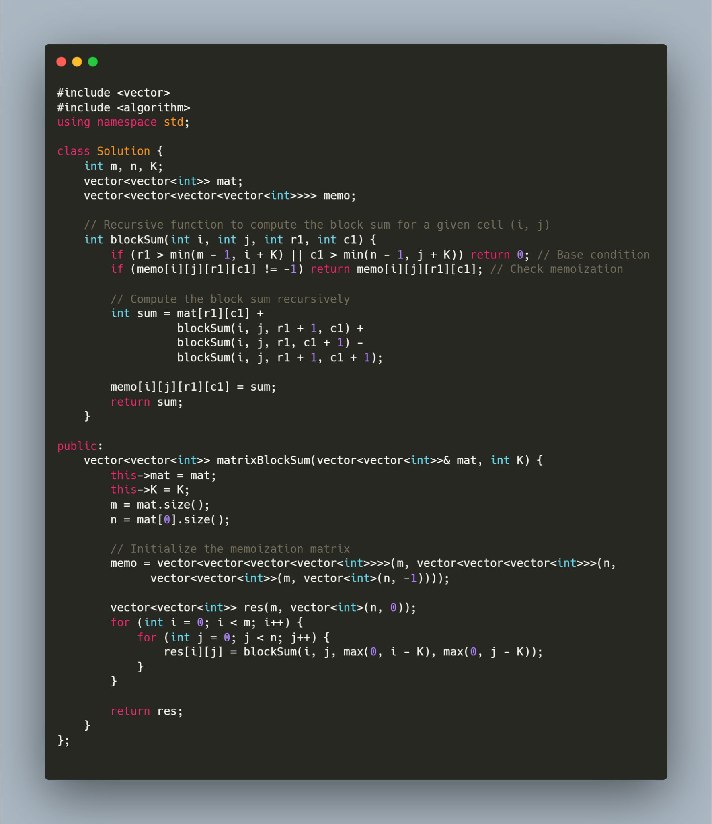
Matrix 2d array
Matrix/2D Array:
https://leetcode.com/problems/matrix-block-sum/
https://leetcode.com/problems/range-sum-query-2d-immutable/
https://leetcode.com/problems/dungeon-game/
https://leetcode.com/problems/triangle/
https://leetcode.com/problems/maximal-square/
https://leetcode.com/problems/minimum-falling-path-sum/

Slide 23
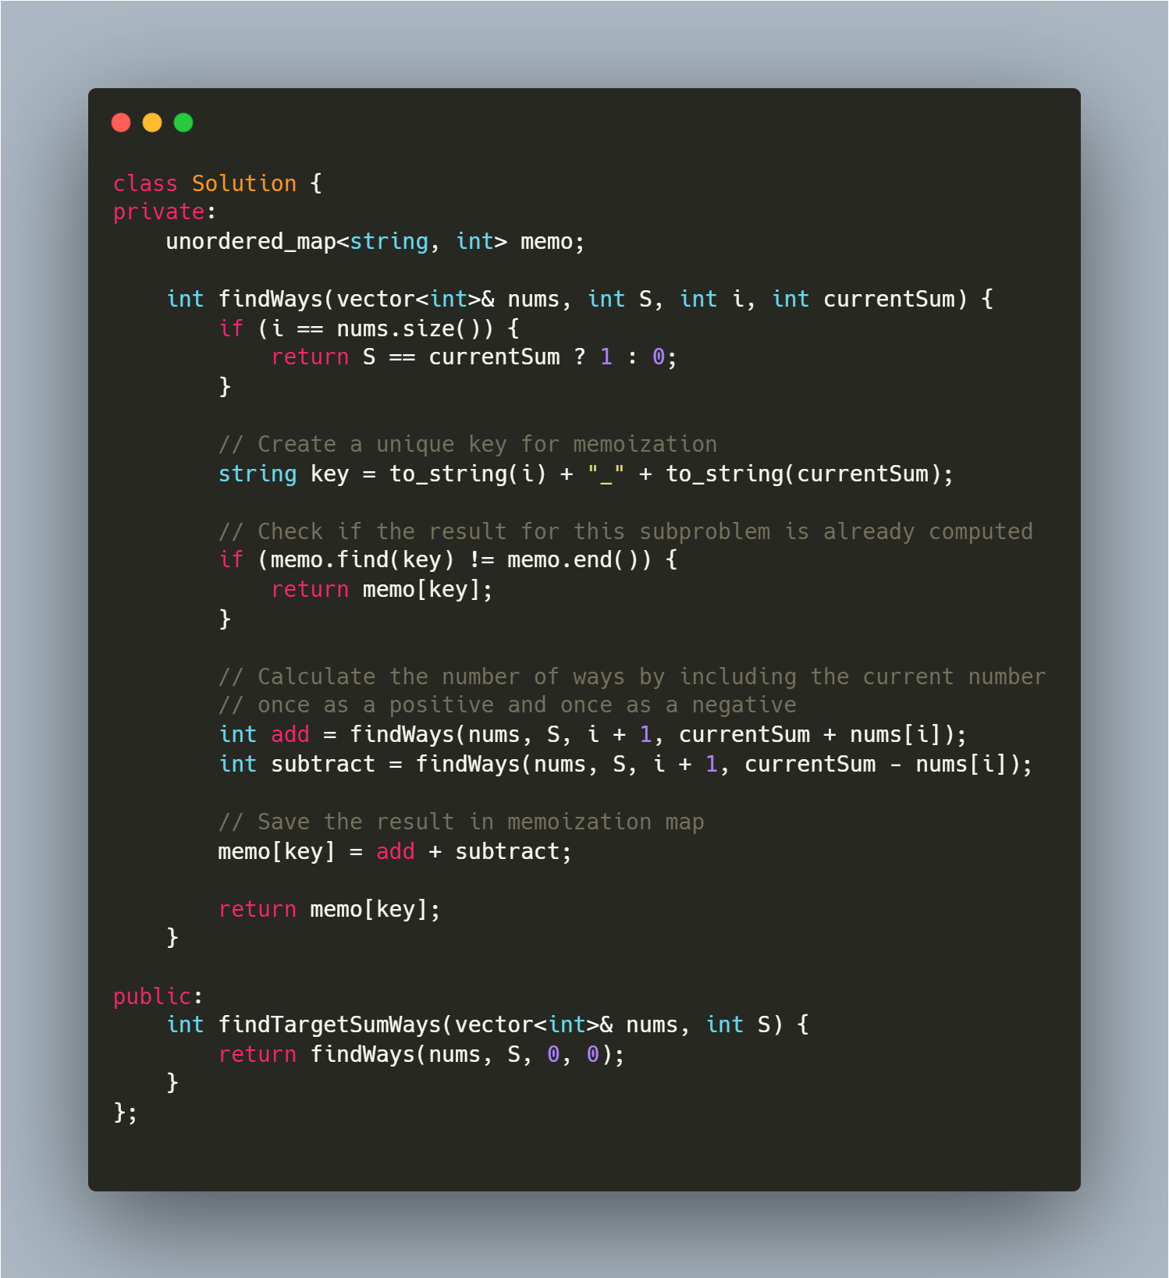
Hash DP
Hash + DP:
https://leetcode.com/problems/target-sum/
https://leetcode.com/problems/longest-arithmetic-sequence/
https://leetcode.com/problems/longest-arithmetic-subsequence-of-given-difference/
https://leetcode.com/problems/maximum-product-of-splitted-binary-tree/

Slide 24
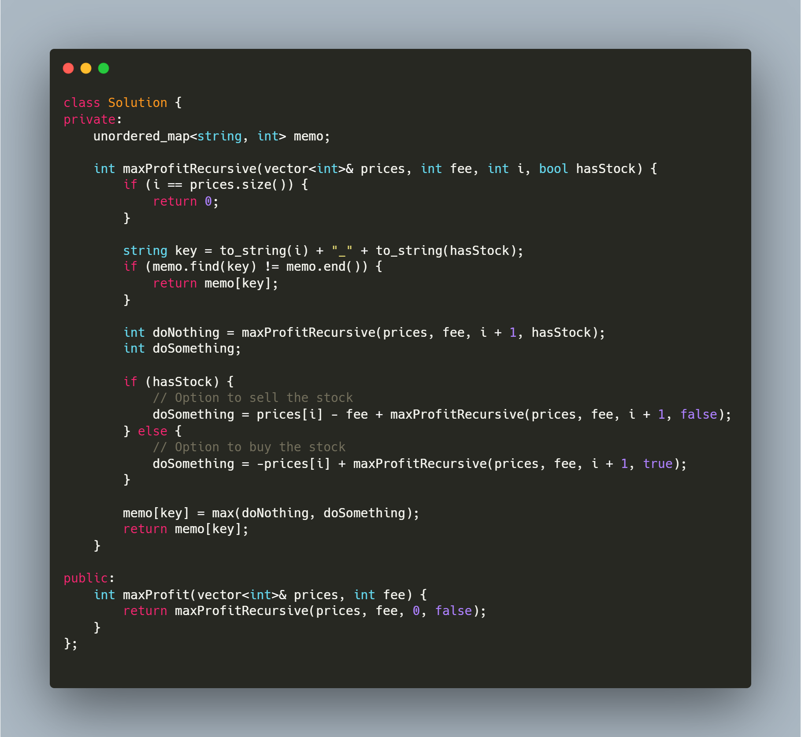
State machine
State machine:
https://leetcode.com/problems/best-time-to-buy-and-sell-stock/
https://leetcode.com/problems/best-time-to-buy-and-sell-stock-ii/
https://leetcode.com/problems/best-time-to-buy-and-sell-stock-iii/
https://leetcode.com/problems/best-time-to-buy-and-sell-stock-iv/
https://leetcode.com/problems/best-time-to-buy-and-sell-stock-with-cooldown/
https://leetcode.com/problems/best-time-to-buy-and-sell-stock-with-transaction-fee/

Slide 25
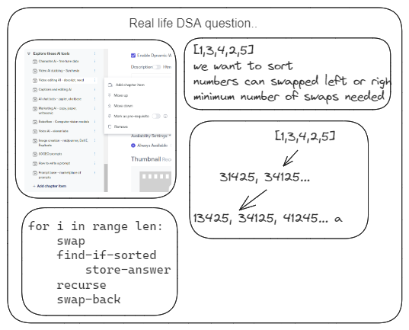
Real life

Slide 26
Leetcode articles
https://leetcode.com/discuss/general-discussion/665604/Important-and-Useful-links-from-all-over-the-Leetcode
https://leetcode.com/discuss/general-discussion/458695/dynamic-programming-patterns

Slide 27
GRAPHS
A-Z

Slide 28
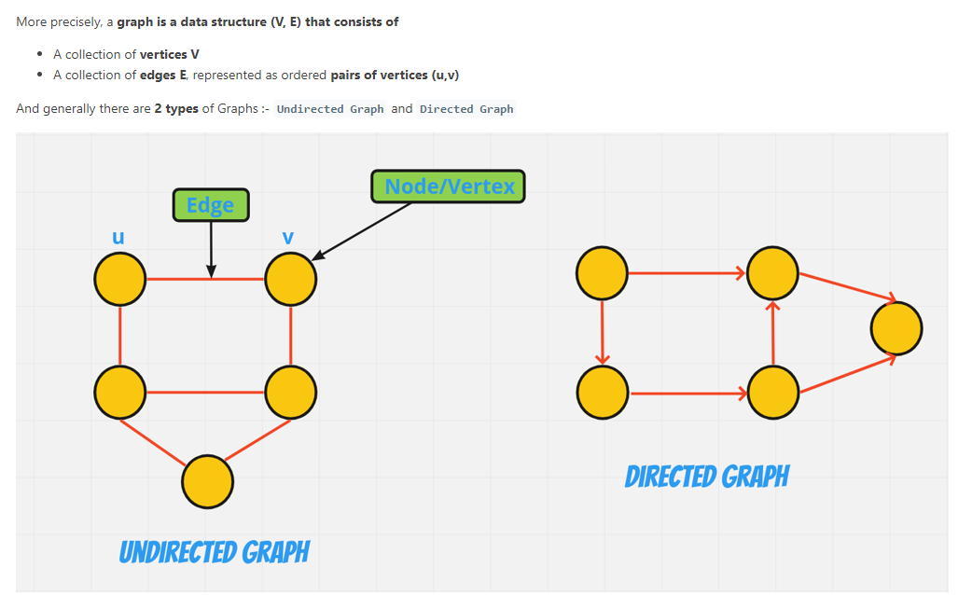

Slide 29
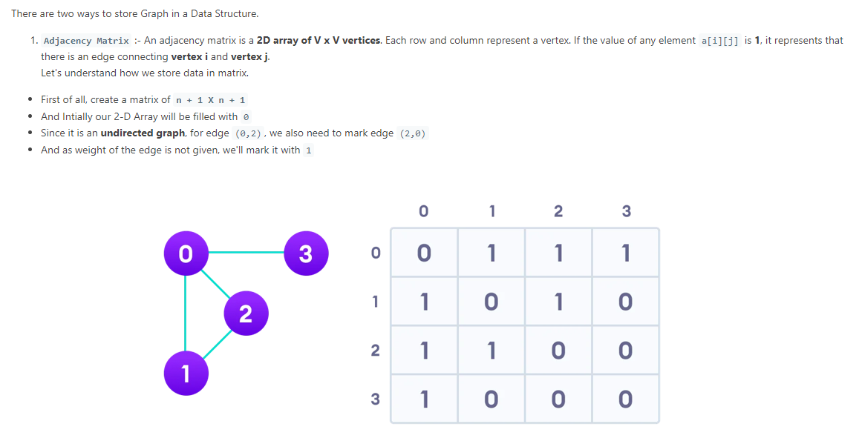

Slide 30
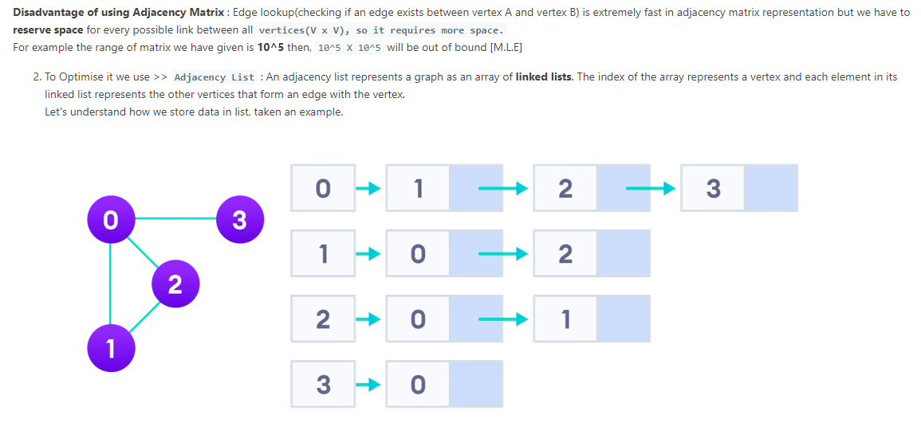

Slide 31
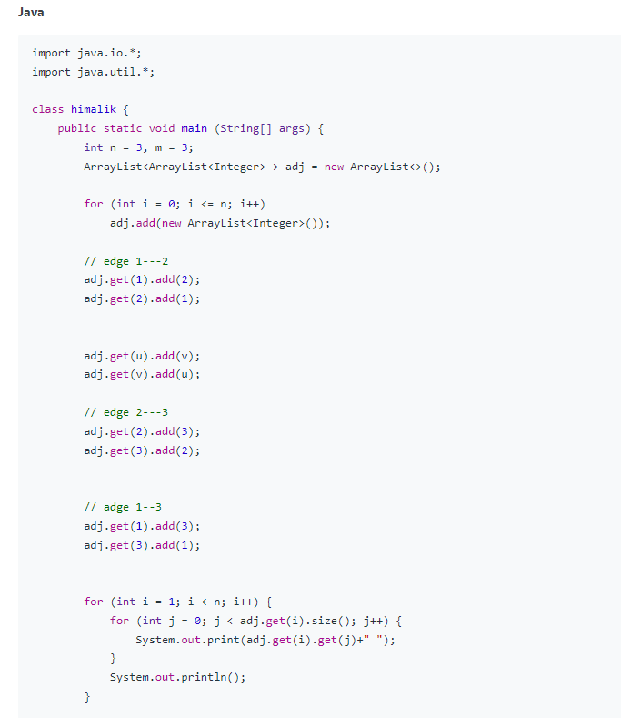

Slide 32
LEETCODE ARTICLES
https://leetcode.com/discuss/general-discussion/655708/Graph-For-Beginners-Problems-or-Pattern-or-Sample-Solutions
https://leetcode.com/discuss/study-guide/2360573/Become-Master-In-Graph

Slide 33
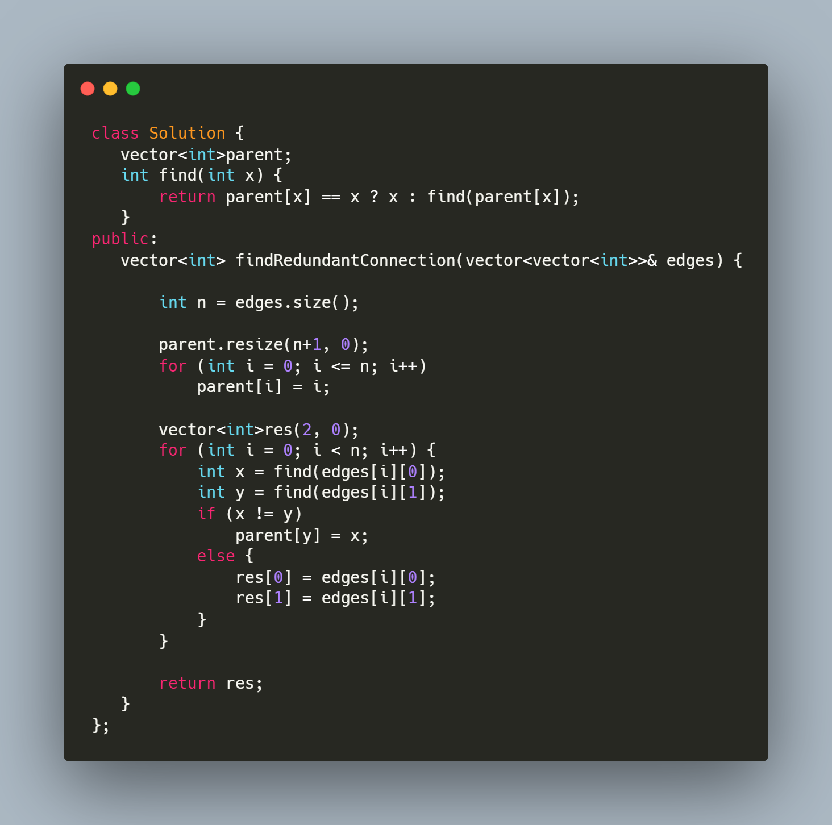
UNION FIND
Union Find:
Identify if problems talks about finding groups or components.
https://leetcode.com/problems/friend-circles/ https://leetcode.com/problems/redundant-connection/ https://leetcode.com/problems/most-stones-removed-with-same-row-or-column/ https://leetcode.com/problems/number-of-operations-to-make-network-connected/ https://leetcode.com/problems/satisfiability-of-equality-equations/ https://leetcode.com/problems/accounts-merge/

Slide 34
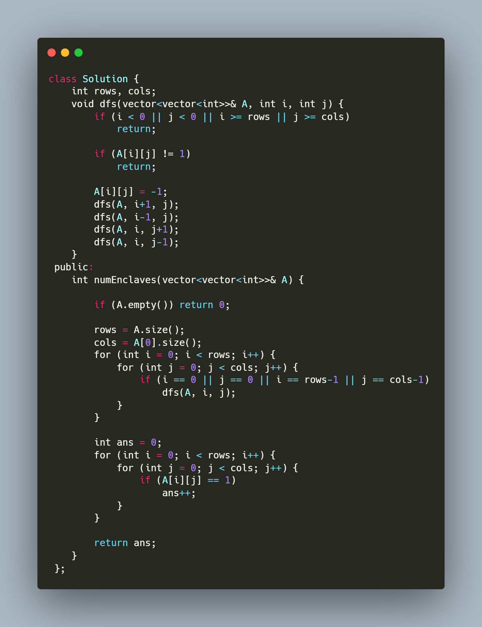
DFS
Start DFS from nodes at boundary:
https://leetcode.com/problems/surrounded-regions/
https://leetcode.com/problems/number-of-enclaves/

Slide 35
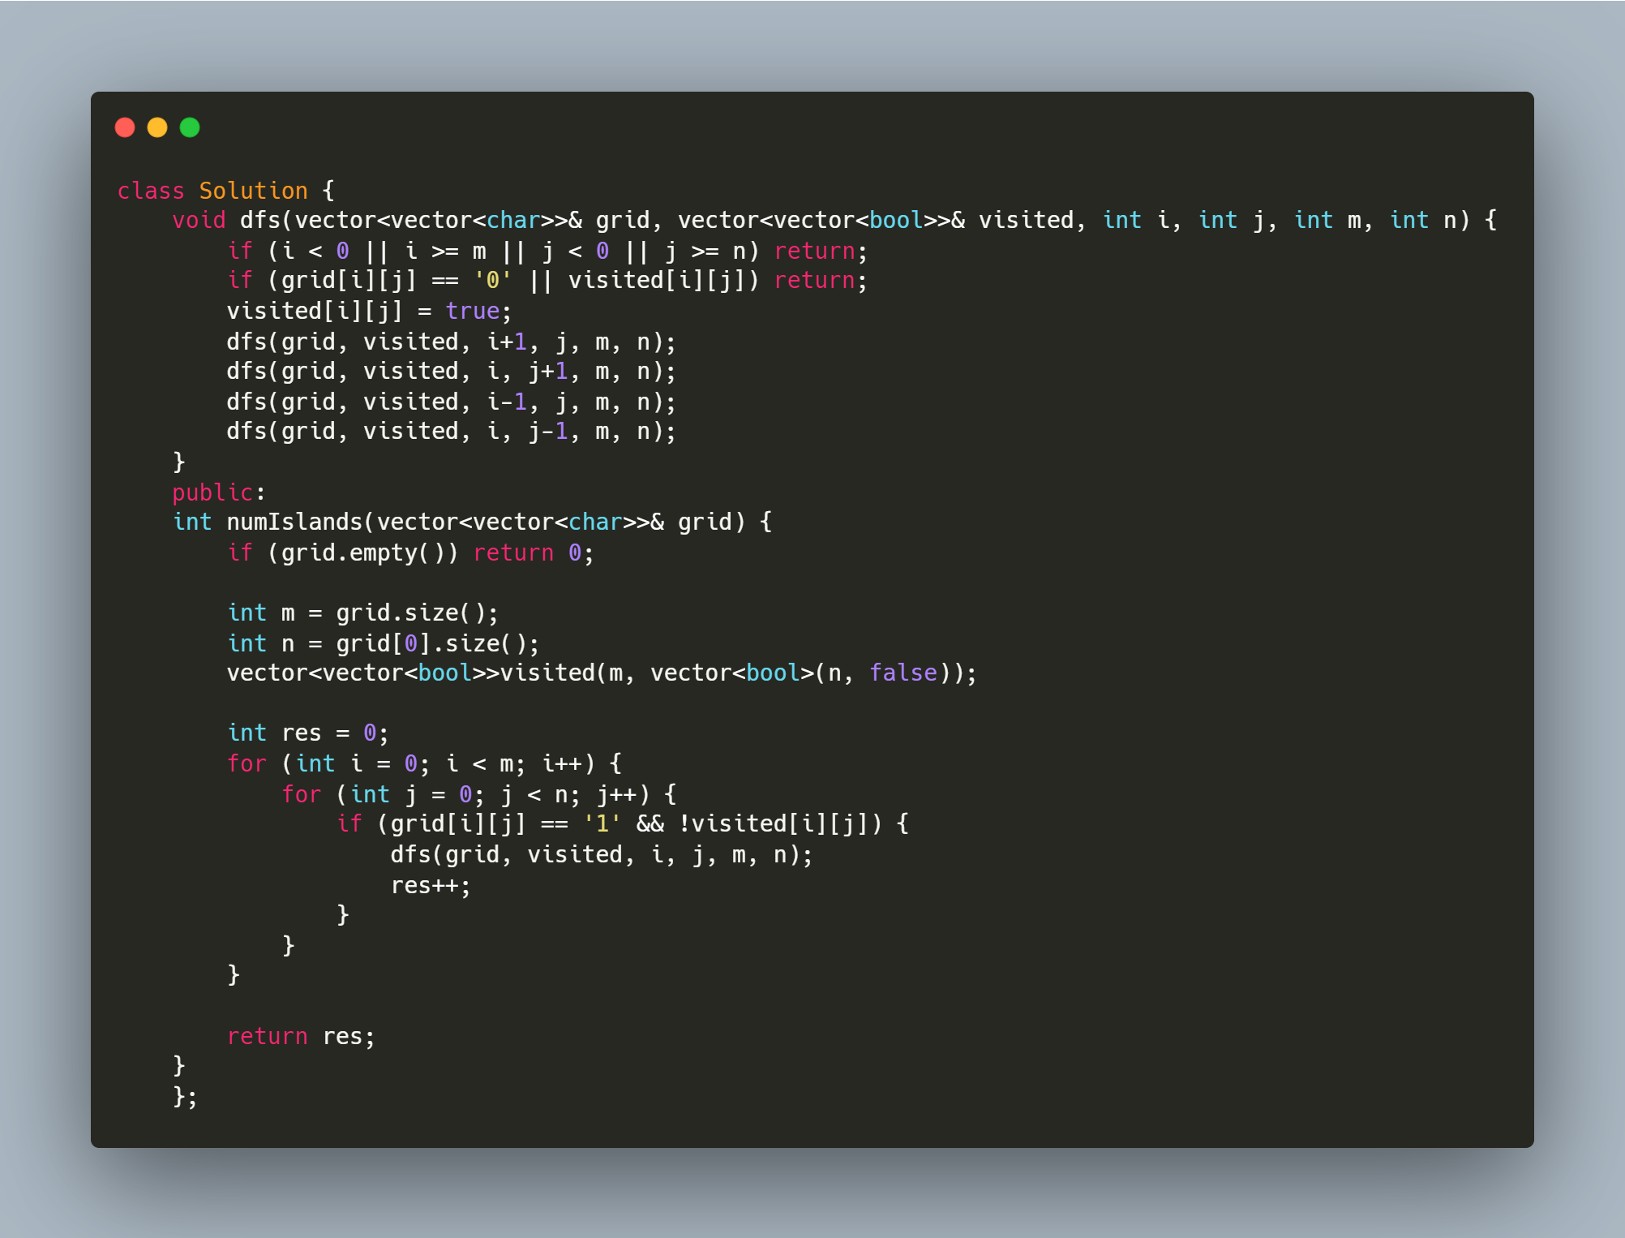
DFS PART 2
DFS from each unvisited node/Island problems
https://leetcode.com/problems/number-of-closed-islands/
https://leetcode.com/problems/number-of-islands/
https://leetcode.com/problems/keys-and-rooms/
https://leetcode.com/problems/max-area-of-island/
https://leetcode.com/problems/flood-fill/

Slide 36
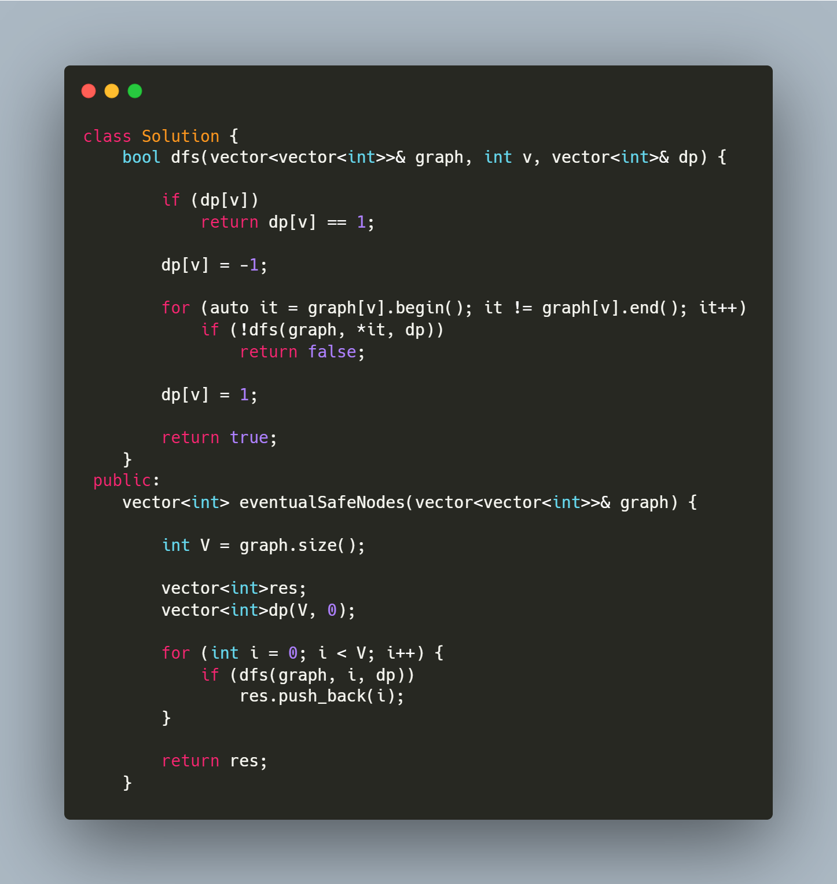
CYCLE FINDING

Slide 37
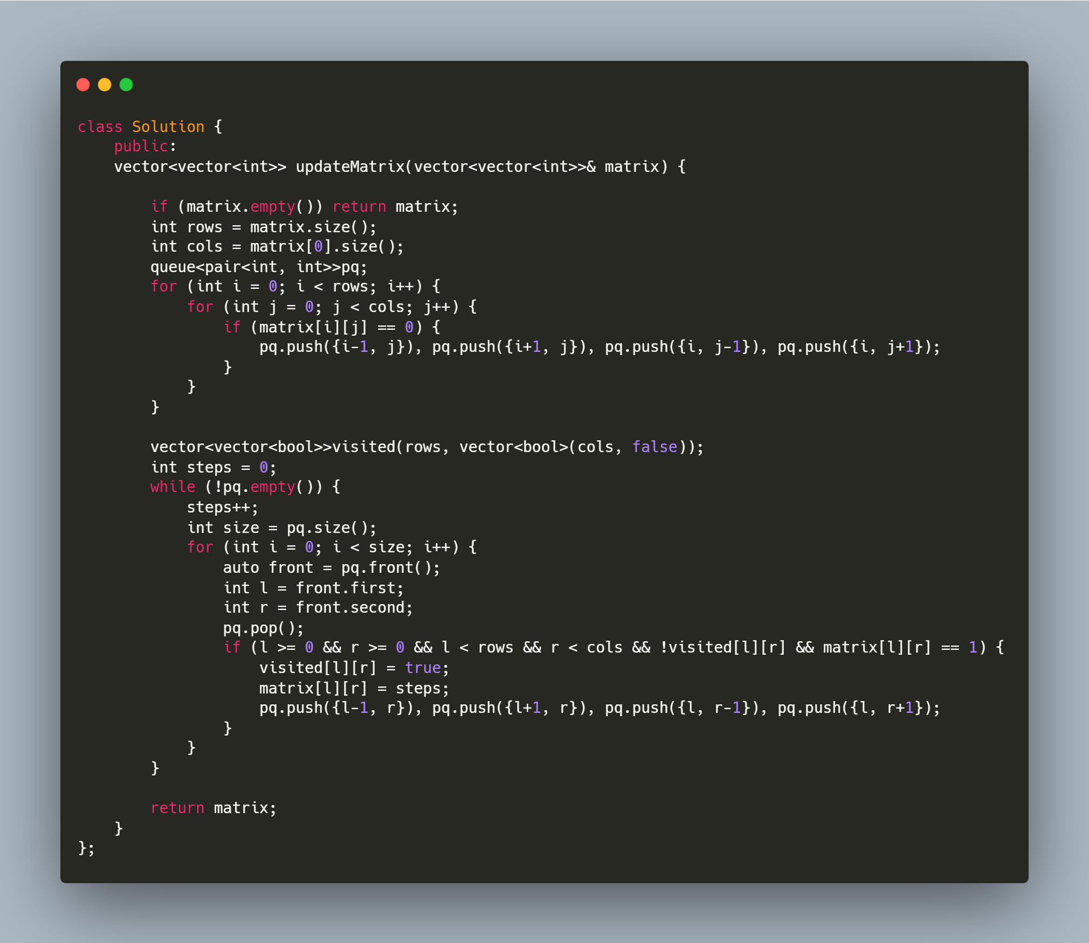
Breadth First Search
Shortest Path: https://leetcode.com/problems/01-matrix/ https://leetcode.com/problems/as-far-from-land-as-possible/ https://leetcode.com/problems/rotting-oranges/ https://leetcode.com/problems/shortest-path-in-binary-matrix/

Slide 38
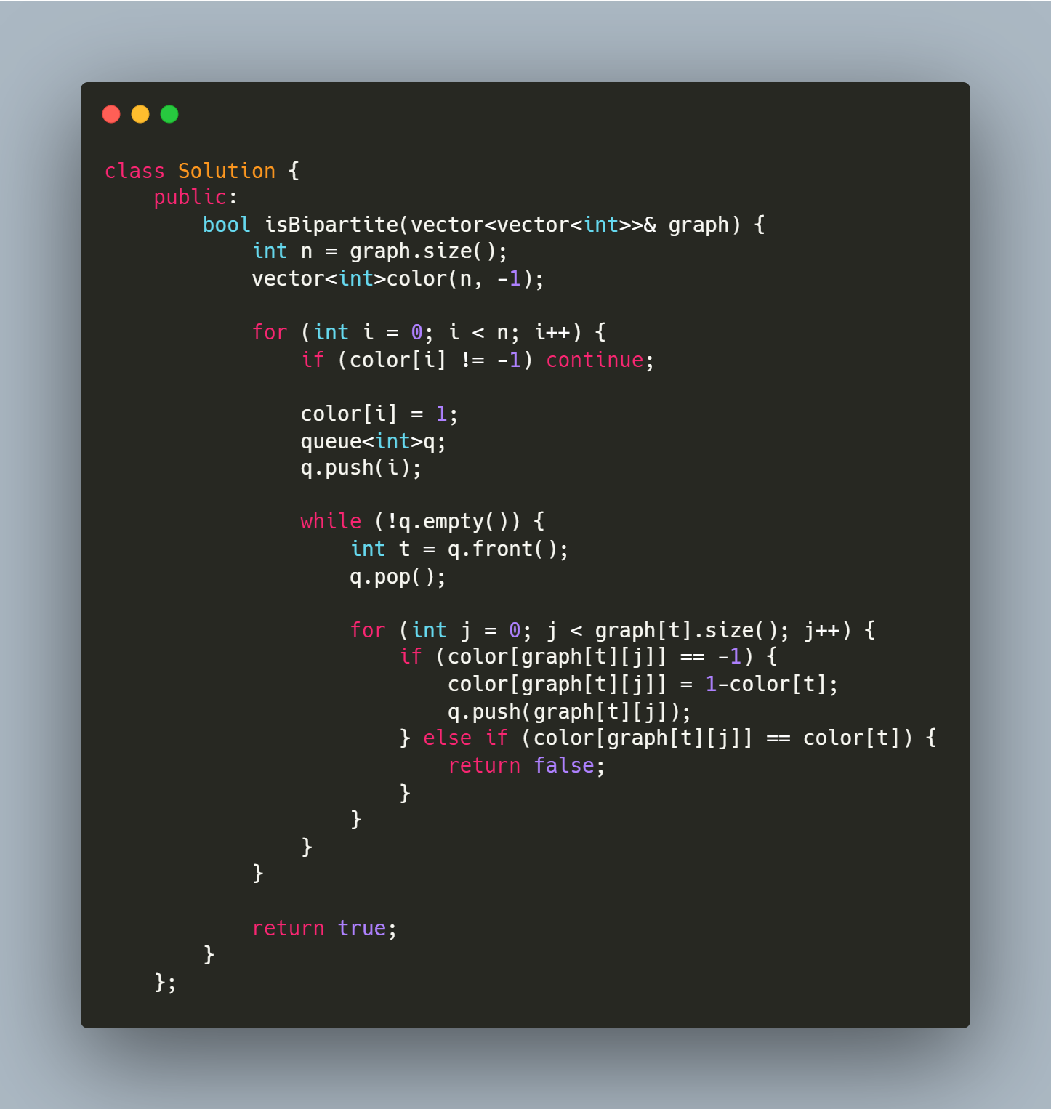
GRAPH COLORING
Graph coloring/Bipartition https://leetcode.com/problems/possible-bipartition/ https://leetcode.com/problems/is-graph-bipartite/
Problems asks to check if its possible to divide the graph nodes into 2 groups Apply BFS for same. Below is a sample graph coloring approach.

Slide 39
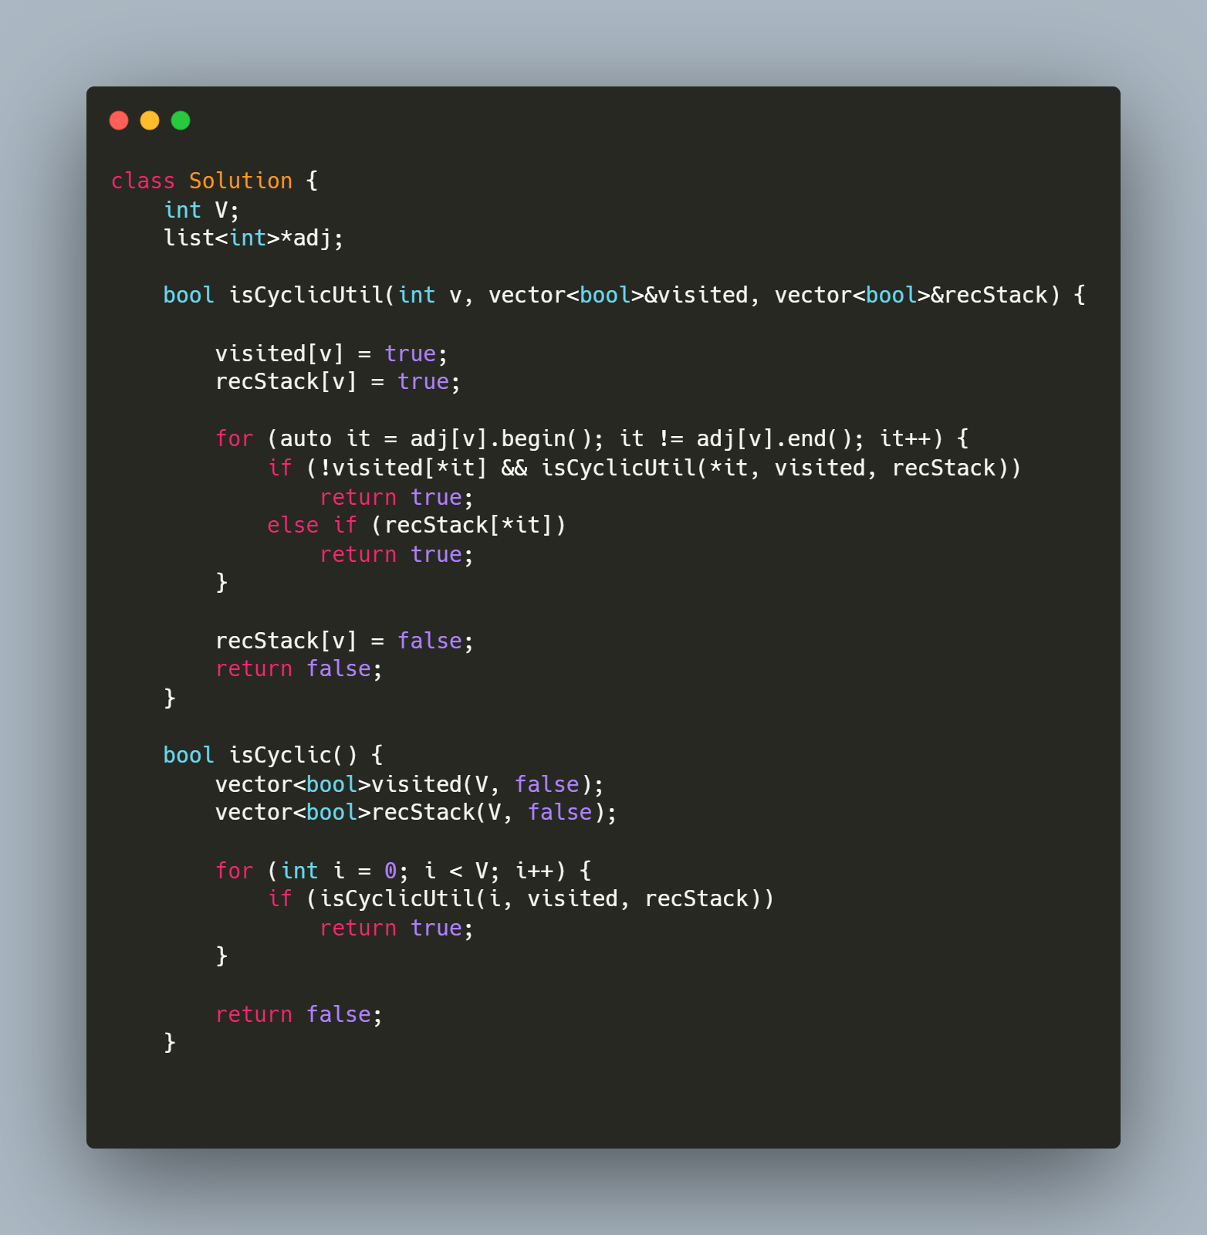
TOPO SORTING
Topological Sort: Check if its directed acyclic graph and we have to arrange the elements in an order in which we need to select the most independent node at first. Number of in-node 0
https://leetcode.com/problems/course-schedule/ https://leetcode.com/problems/course-schedule-ii/

Slide 40
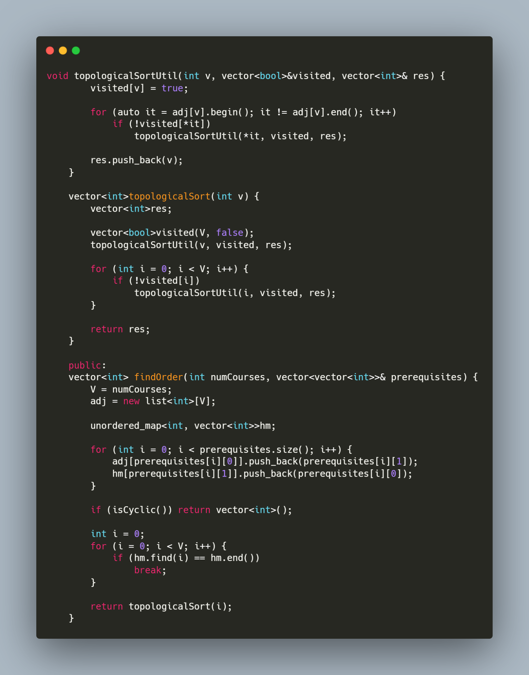
TOPO SORTING PART 2

Slide 41
DFS - Iterative and recursive solutions

Slide 42
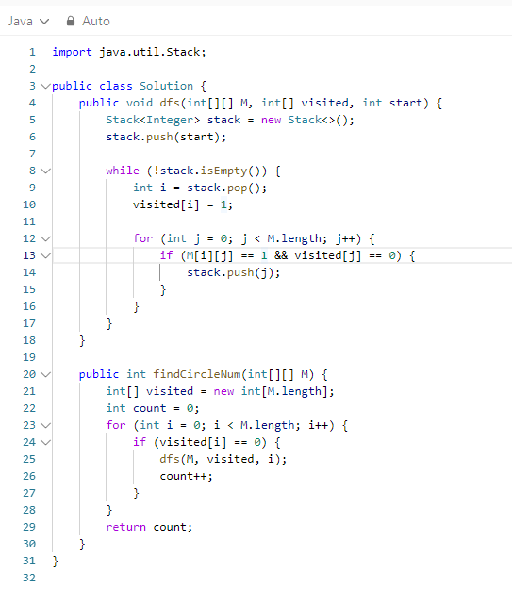
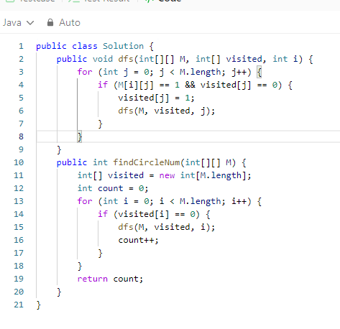

Slide 43
LEETCODE ARTICLES
https://leetcode.com/discuss/general-discussion/655708/Graph-For-Beginners-Problems-or-Pattern-or-Sample-Solutions
https://leetcode.com/discuss/study-guide/2360573/Become-Master-In-Graph

Slide 44
Trees - traversals

Slide 45
DFS iterative

Slide 46
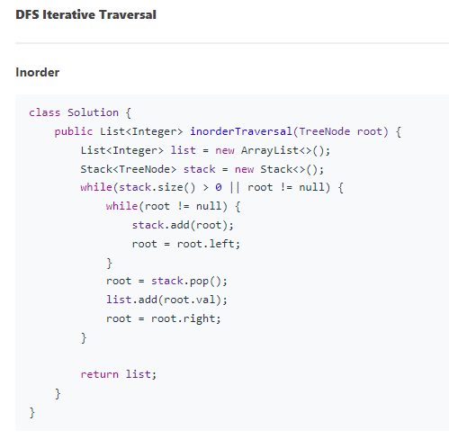

Slide 47
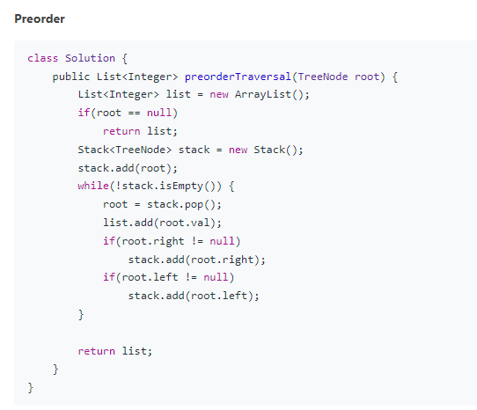
Preorder traversal

Slide 48
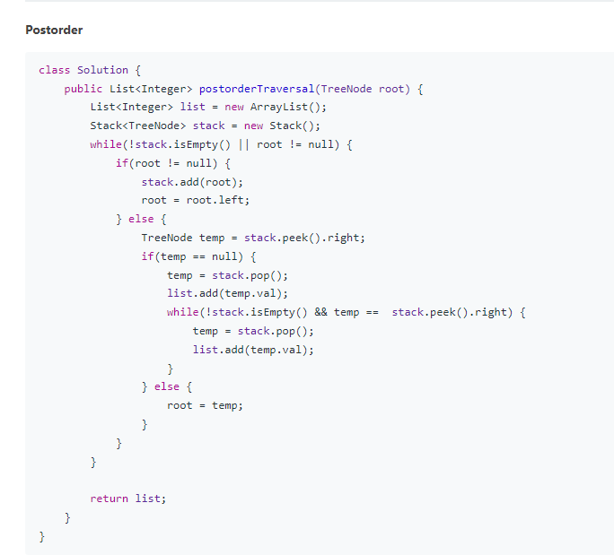

Slide 49
DFS recursive

Slide 50
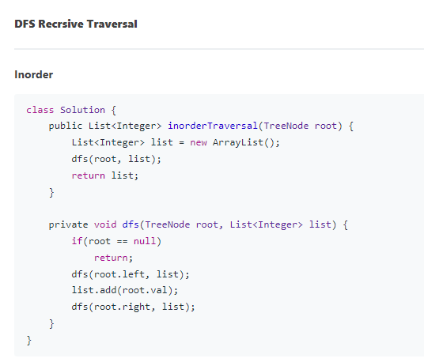

Slide 51
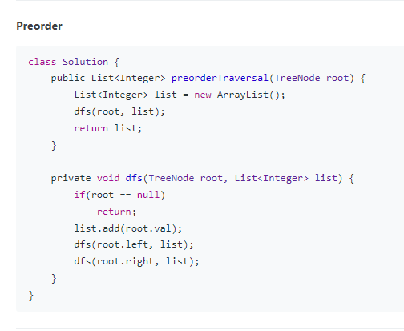

Slide 52
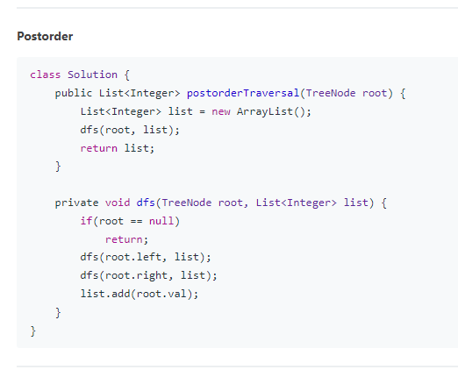

Slide 53
Other traversals

Slide 54
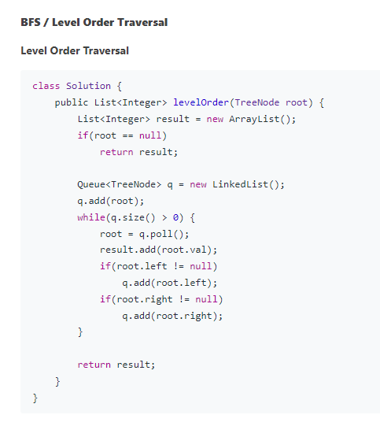

Slide 55
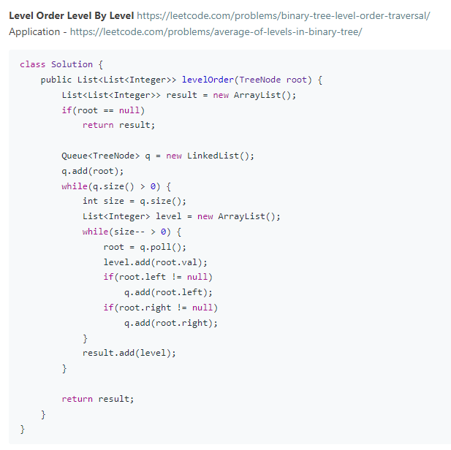

Slide 56
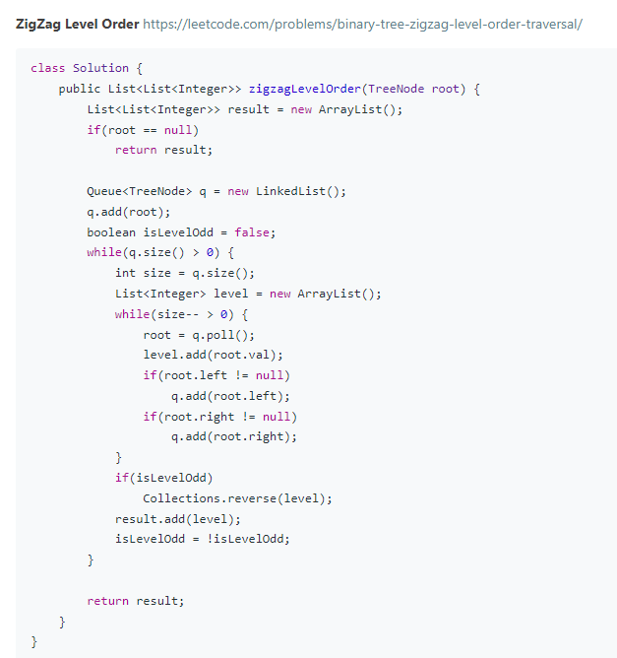

Slide 57
Leetcode articles
https://leetcode.com/discuss/general-discussion/937307/iterative-recursive-dfs-bfs-tree-traversal-in-pre-post-levelorder-views
https://leetcode.com/discuss/study-guide/1212004/binary-trees-study-guide

